Slide 1
“ Face Recognition Based Student Attendance System in Python using OpenCV with Tkinter GUI ”

Slide 2
CONTENTS
Title
Introduction
Problem Statement
Aims and Objectives
Literature Review
Methodology
System Analysis and design
Result and analysis
Reference

Slide 3
Project features
Long term storage of records
· High accuracy in calculation.
· Time saving Work space
Data consistency
· Optimize the resource
· Efficiency in modification, sorting and retrieval of data.
· Inexpensive updating in facilities and terms of organizations.

Slide 4
INTRODUCTION
´ It is a system for managing the Student attendance effectively
´ It helps to overcome the situation now are facing of using manual system like signature ,RFID, Finger Print based attendance system but they fail to proof attendance system
´ It helps the admin to manage:
Student Attendance record
Image process and manipulation
student Details
Generating student attendance report

Slide 5
PROBLEM STATEMENT
´ The old system of keeping records in Attendance management system. On which records are kept in a paper file by hand. There were many problems such as :-
Lack of security
Time consuming
Consumes large volume of paperwork.
lack of storage.
Difficulty in data searching

Slide 6
Aims and Objectives
To develop a portable Smart Attendance System which is handy and self-powered.
To ensure the speed of the attendance recording process is faster than the previous system which can go as fast as approximately 3 second for each student.
To detect unique faces with the help of computer’s camera
Able to recognize the face of an individual accurately based on the face database.
Allow parents to track their child’s attendance.
Develop a database for the attendance management system.
Provide a user-friendly interface for admins to access the attendance database and for non-admins (parents) to check their child’s attendance by mailing the attendance.

Slide 7
Literature Review
Signature Based Attendance System
Fingerprint Based Attendance System Using Microcontroller and LabView
RFID Based Student Attendance System
Face Recognition Attendance System

Slide 8
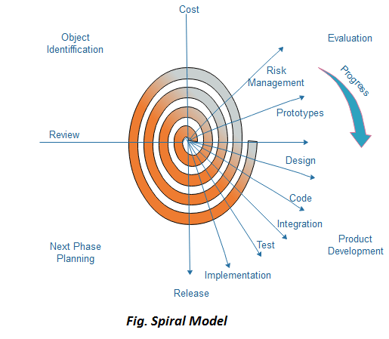
Methodology
Initially proposed by Boehm,
is an evolutionary software process model that couples the iterative feature of prototyping with the controlled and systematic aspects of the linear sequential model.

Slide 9
Software Description
OpenCV: open-source library used for computer vision
HAAR-Cascade Detection in OpenCV
The HAAR cascade is a machine learning approach where a cascade function is trained from a lot of positive and negative images.
OpenCV provides the trainer as well as the detector.
Two primary states of the cascade image classifier first one is training and the other is detection.
two types of samples:
• Negative sample: It is related to non-object images.
• Positive samples: It is a related image with detect objects.

Slide 10
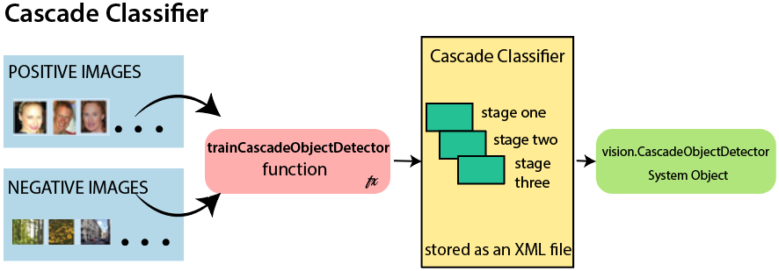
Cascade Classifier Mechanism

Slide 11
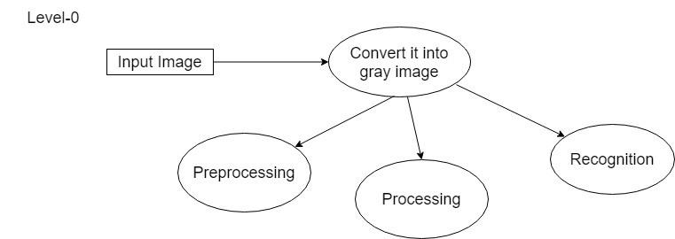
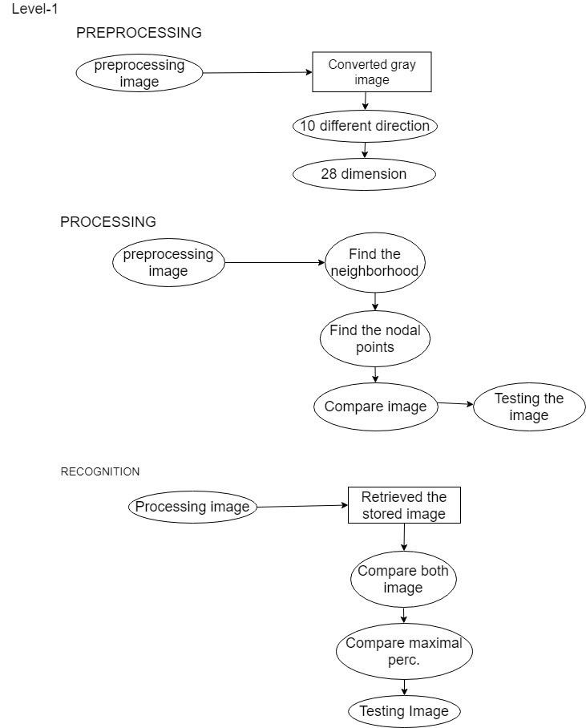
Proposed Block Diagram

Slide 12
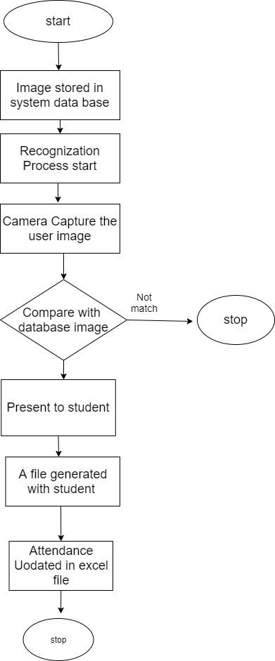
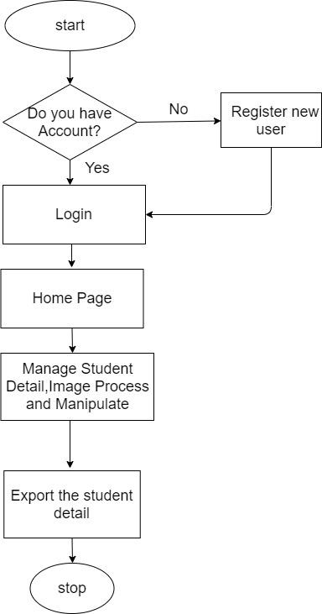
Working Principle
Flow chart for Admin and Face Recognition System

Slide 13
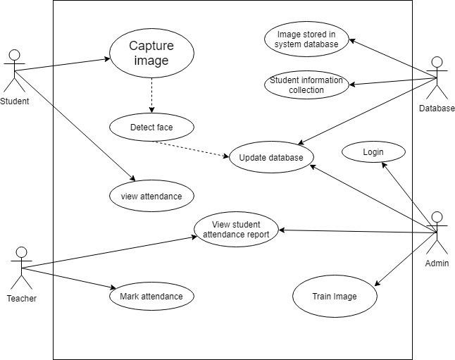
Proposed System Design
Use Case Diagram

Slide 14

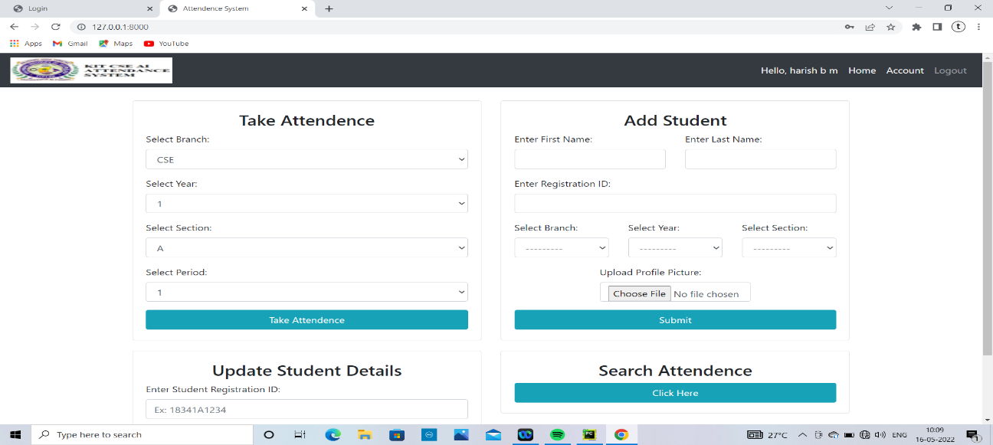
SNAPSHOTS
Login page
Add student details

Slide 15
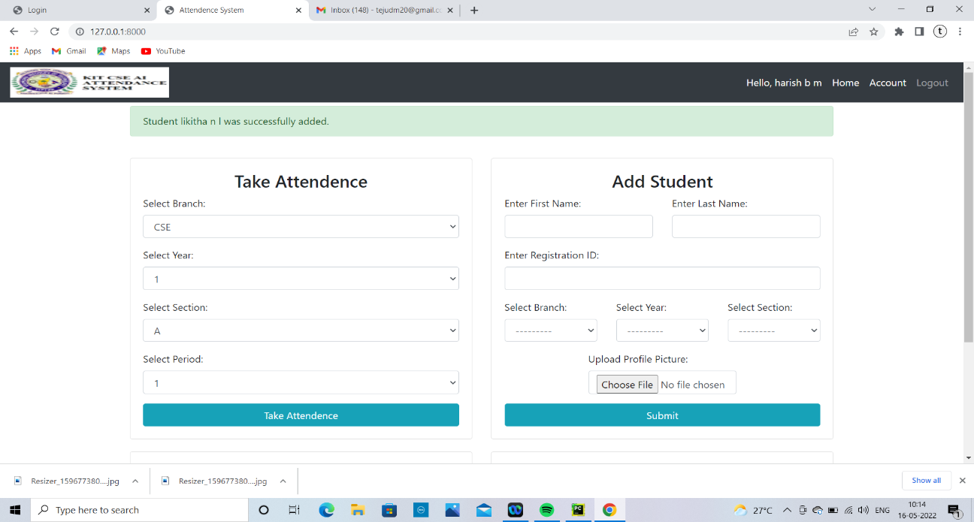
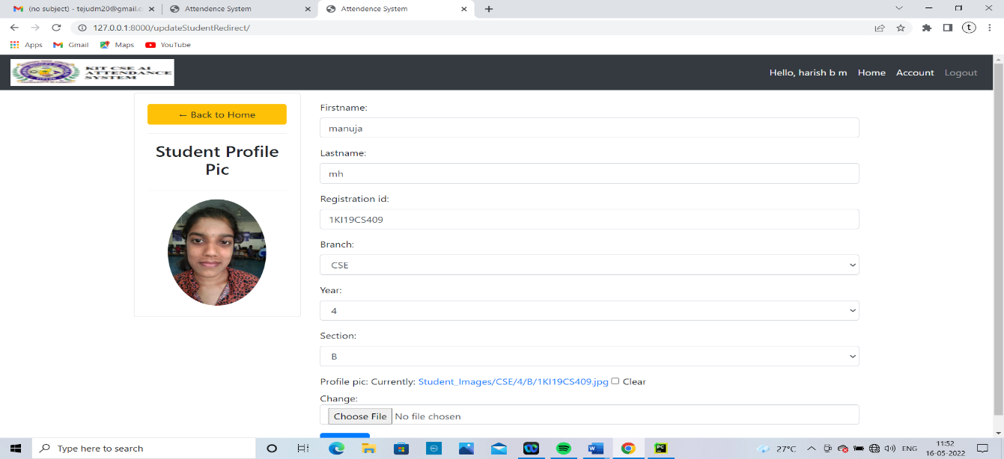
Successfully added student details

Slide 16
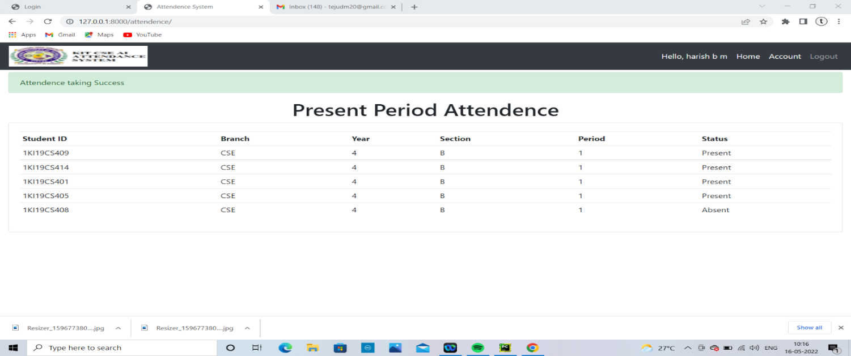
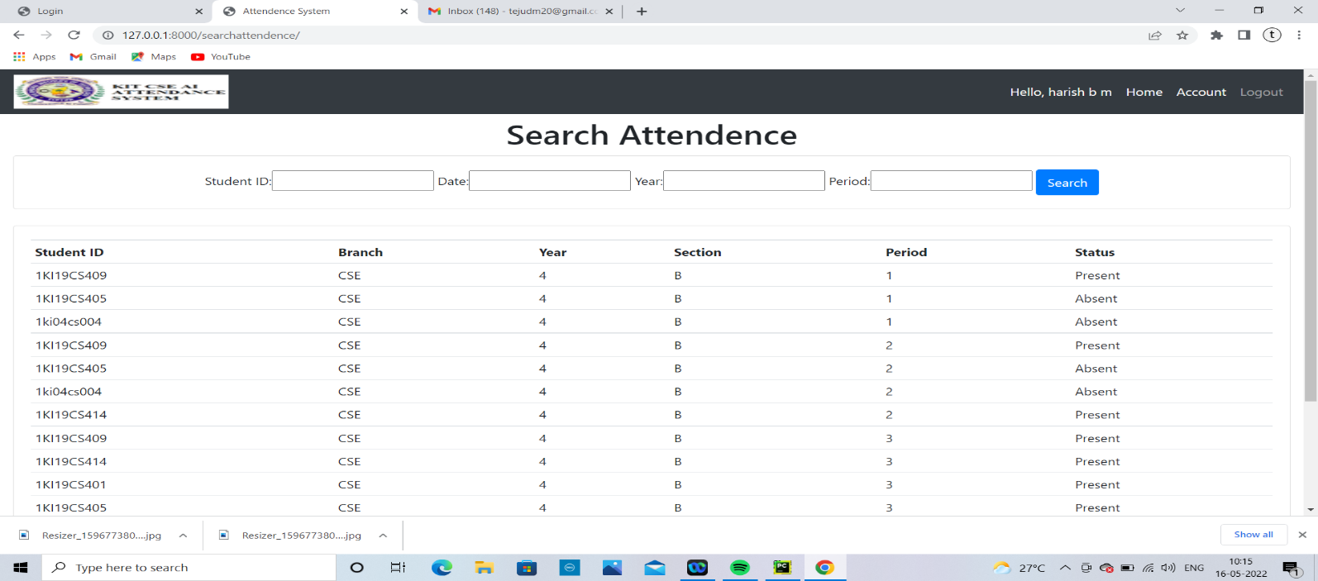
View attendence
Search attendence

Slide 17
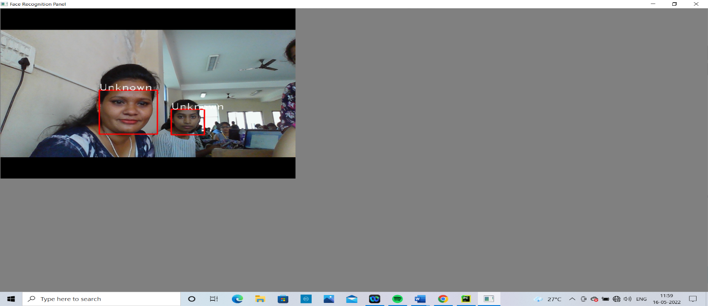

Face not Recognition
Select delete student

Slide 18


Deleting student details
Successfully delete student details

Slide 19
Reference
[1] “Smart Attendance Management and Analysis with Signature Verification”(Hardika Chauhan, Chitaliya Nehal,2017)
[2] “Fingerprint Based Attendance System Using Microcontroller and LabView” (Kumar Yadav, Singh, Pujari, Mishra, 2015)
[3] “A Proposed RFID Based Student Attendance System “(Fawzi M Al-Naima and Maryam Alaa Saleh, (1 May) 2015)
[4] Charles A. Walton, electronic identification & recognition system Filed: Dec. 27, 1971 Appl. No.: 212,281.
[5] https://www.javatpoint.com/
[6] Smart Attendance System using Computer Vision and Machine Learning ( Dipti Kumbhar#1 , Prof. Dr. Y. S. Angal*2 # Department of Electronics and Telecommunication, BSIOTR, Wagholi, Pune, (7 July) 2017)
[7] Bifari, E.N.; Elrefaei, L.A.“Automated Fingerprint Identification System Based on Weighted Feature Points Matching Algorithm”, 978-1-4799-3080-7114/$31.00 ©2014 IEEE
[8]. OpenCvDocumentation - https://opencv.org
[9]. Numpy - https://numpy.org
[10].CNN: https://www.academia.edu/Documents/in/CNN

Slide 20
Thank you

